Slide 1
Robust Multi-Source Direction of Arrival Estimation Using a Single Acoustic Vector Sensor
ShanghaiTech University
耿建华
2021.1.12

Slide 2
Background
Current Works
Research Plan
References

Slide 3
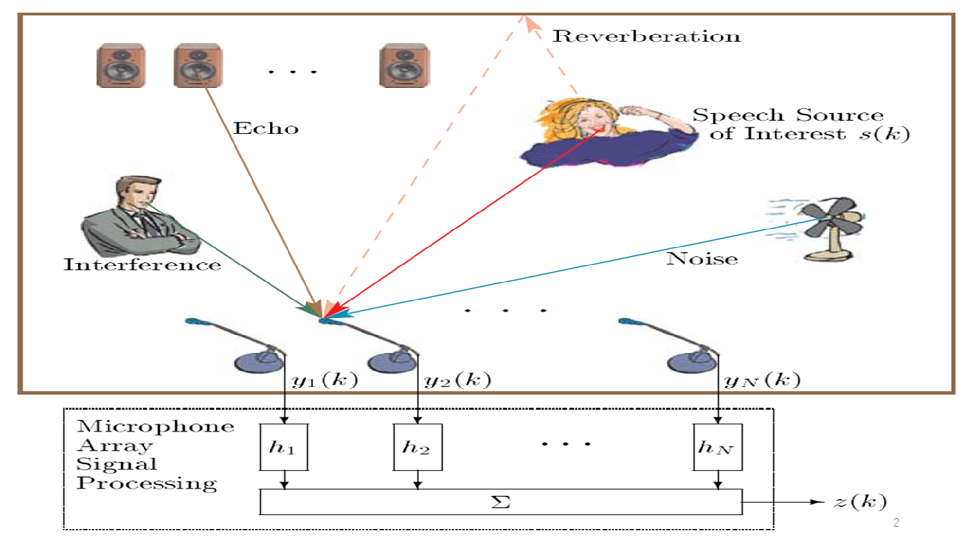
Direction of Arrival (DOA) Estimation
In signal processing, direction of arrival (DOA) denotes the direction from which usually a propagating wave arrives at a point, where usually a set of sensors are located.

Slide 4
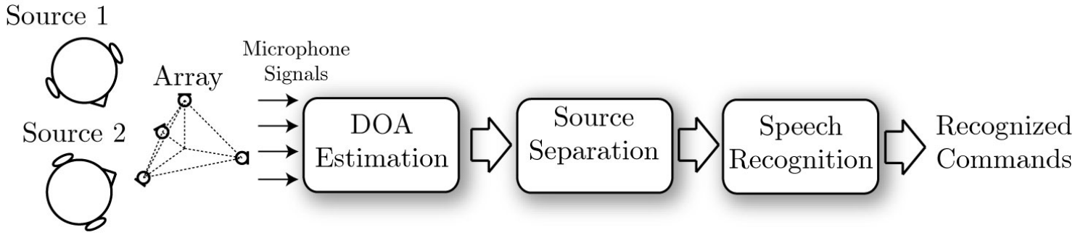
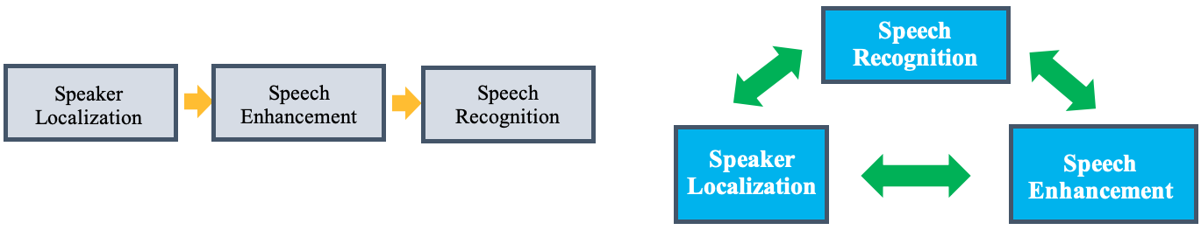
Role of DOA Estimation
DOA estimation is usually used as a fundamental step in array signal processing and audio signal processing.

Slide 5
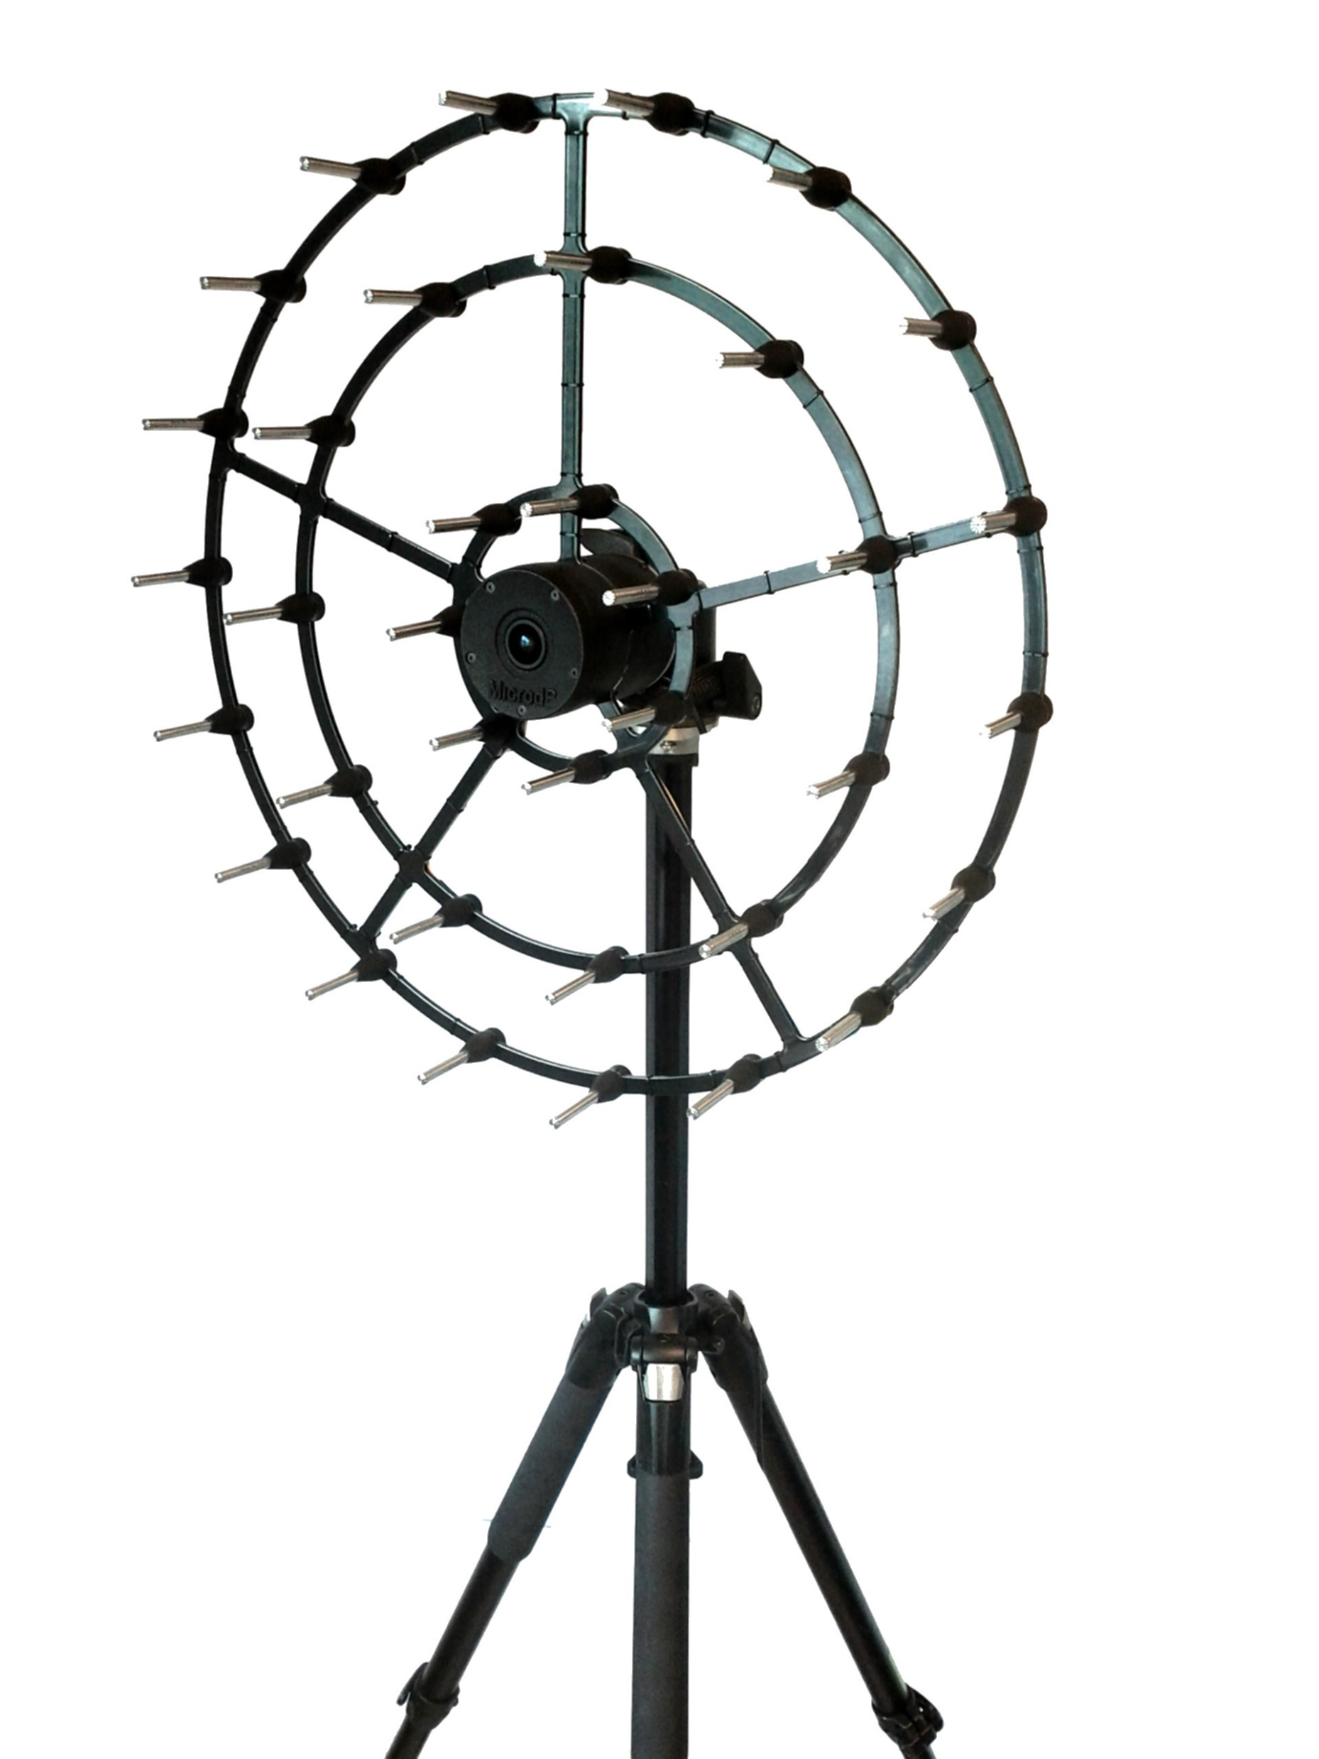
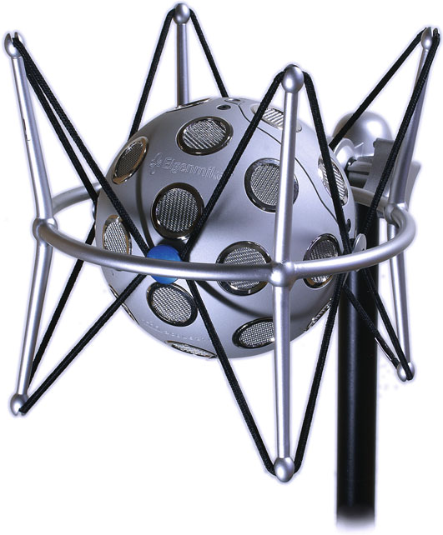
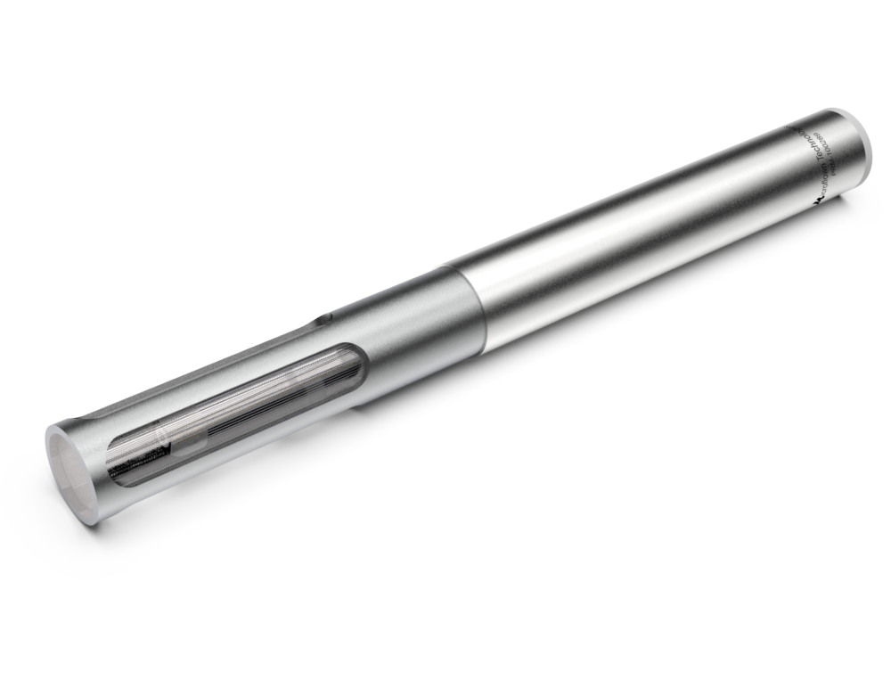
Equipment in DOA Estimation

Slide 6
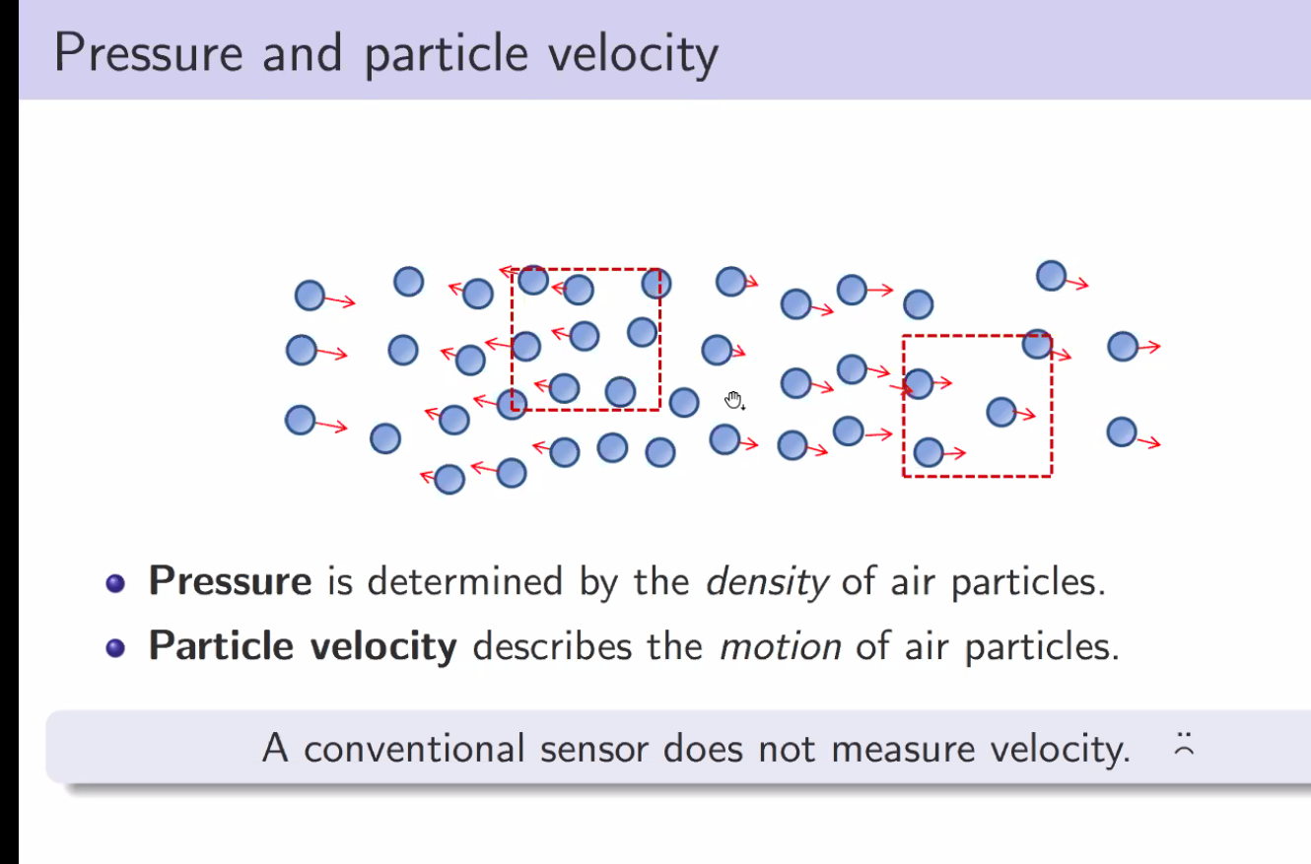
Sound Field
is determined by the density of air particles.
describes the motion of air particles.
Note: A conventional sensor does not measure velocity.

Slide 7
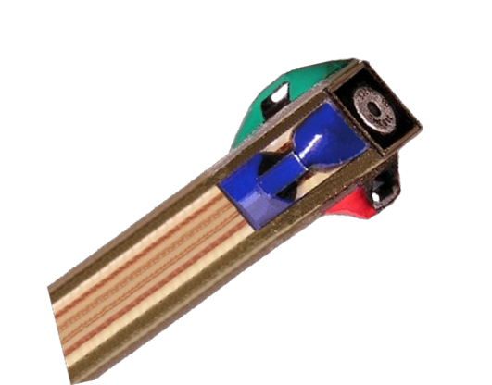
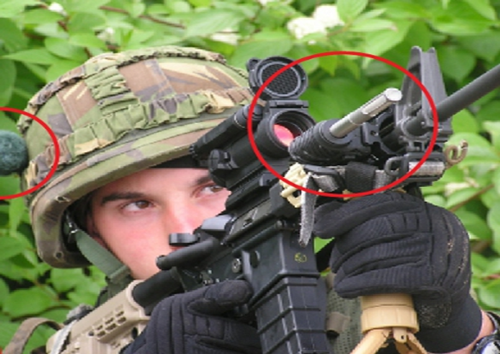
Acoustic Vector Sensor (AVS)
Why AVS ?
A vector sensor measures both pressure and particle velocity.
Compact configuration, low weight (100g), low power (<1Watt).
Frequency-independence property.
y
Omni-directional
z
x

Slide 8
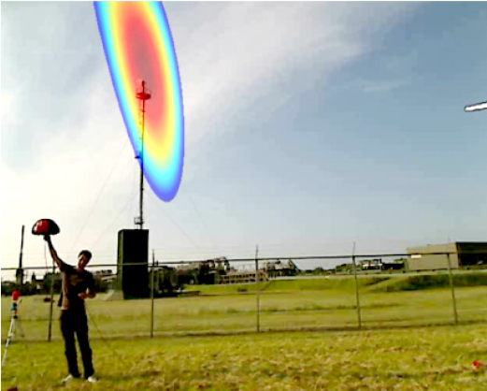
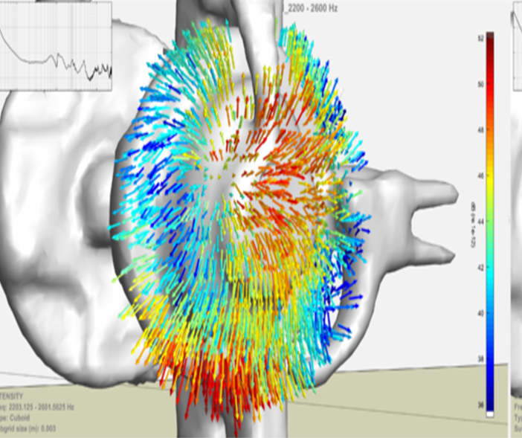
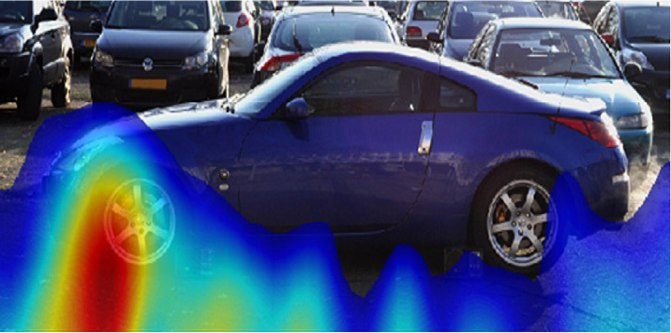
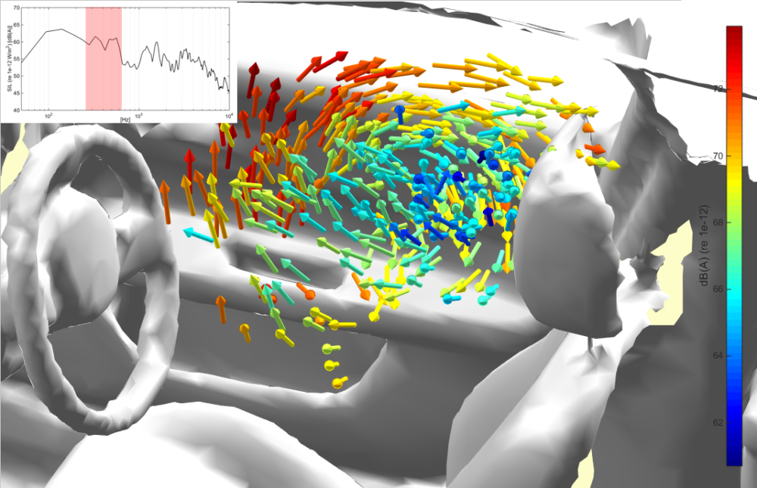
Applications of AVS

Slide 9
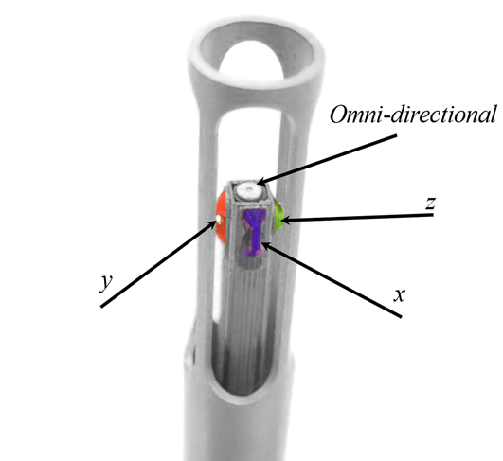
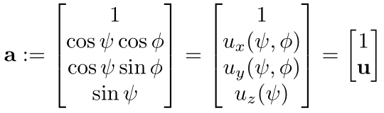
AVS Configuration
Benefited from the frequency-independence property as well as the direct measurement of acoustic particle velocity, a single AVS is suitable for broadband acoustic source DOA estimation.
Notes:
声场由声压和声粒子速度构成，一个标量一个矢量。

Slide 10
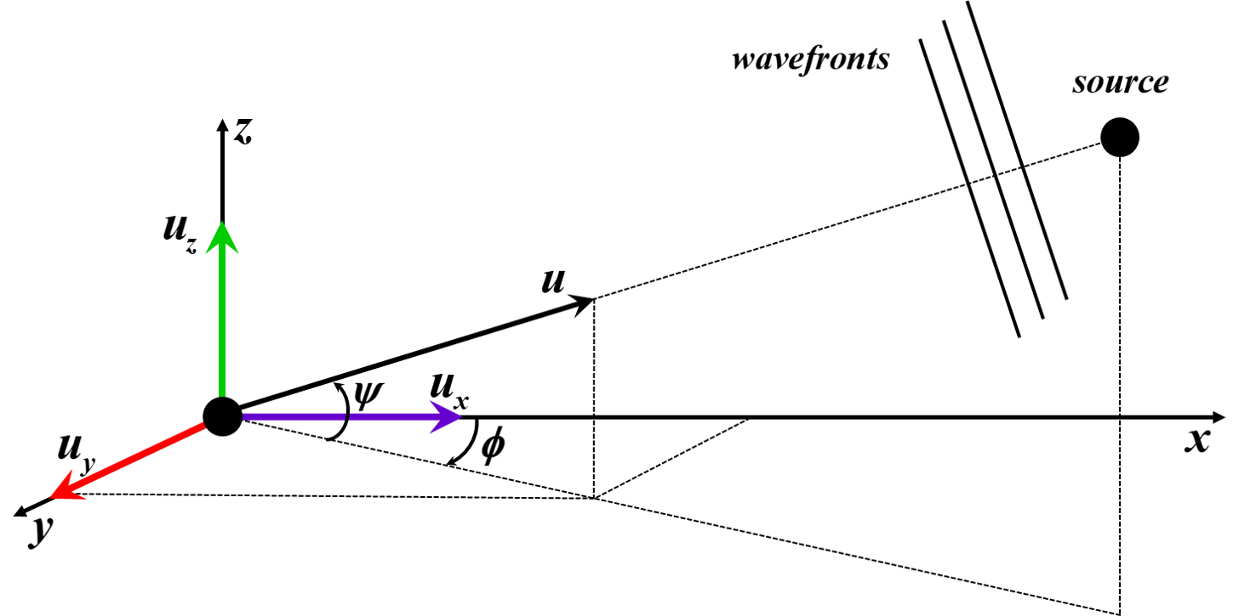
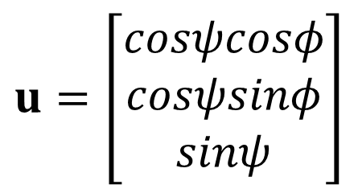
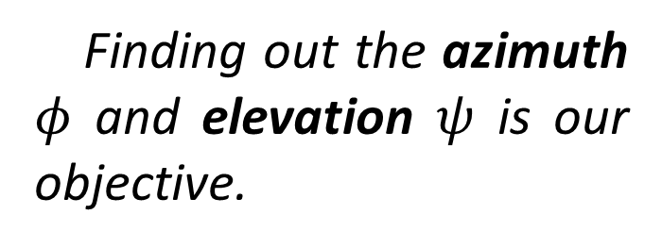
Single AVS Received Signal Model
$$u=\left[\begin{aligned}\begin{aligned}cosψcosφ \\ cosψsinφ\end{aligned} \\ sinψ\end{aligned}\right]$$
Finding out the azimuth $φ$ and elevation $ψ$ is our objective.

Slide 11
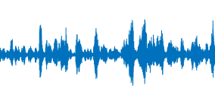
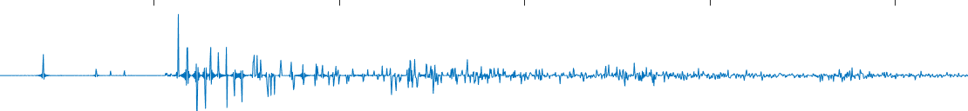
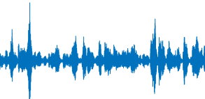
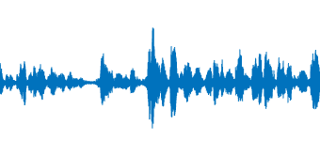
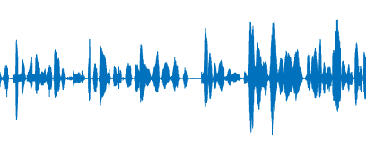
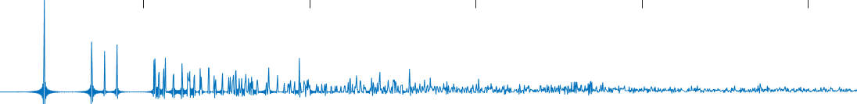
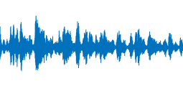
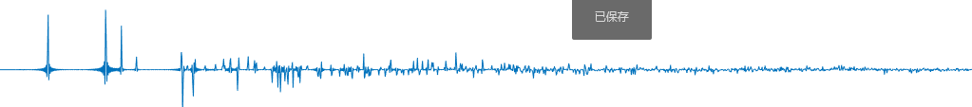
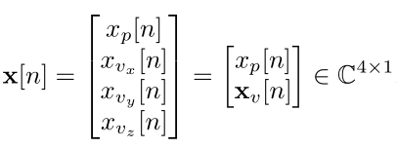
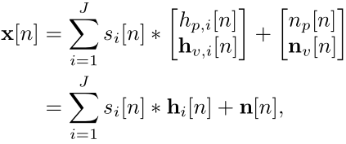
Received Signal Model in Time Domain
The received signal of AVS are denoted and modeled as:

Slide 12
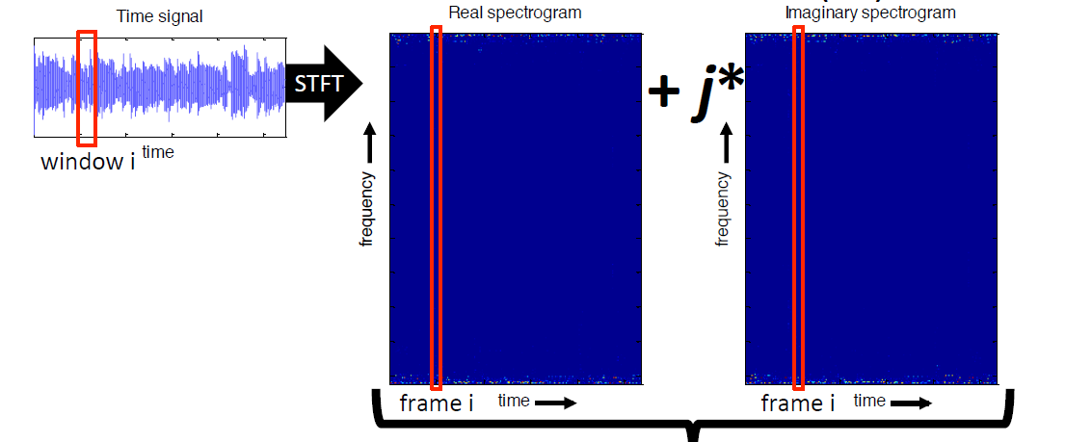
Short Time Fourier-Transform (STFT)
Due to non-stationarity and TF sparsity of speech, the received signals are usually processed in the TF domain.

Slide 13
Advances in AVS Based DOA Estimation
Hefezi et al.
Estimation consistency
2018
Nadiri et al.
Wu Kai et al.
Direct path dominant test
Low reverberant single source points detection
Free space model
2017
2014
Levin et al.
2012
Maximum steered response power estimator
Levin et al.
Maximum likelihood estimator
Techniques of selecting points
Nehorai et al.
Covariance-based estimator
2011
1994
CNN
CRNN
U-net
SVM
…
Nehorai et al.
Others
Intensity-vector based estimator

Slide 14
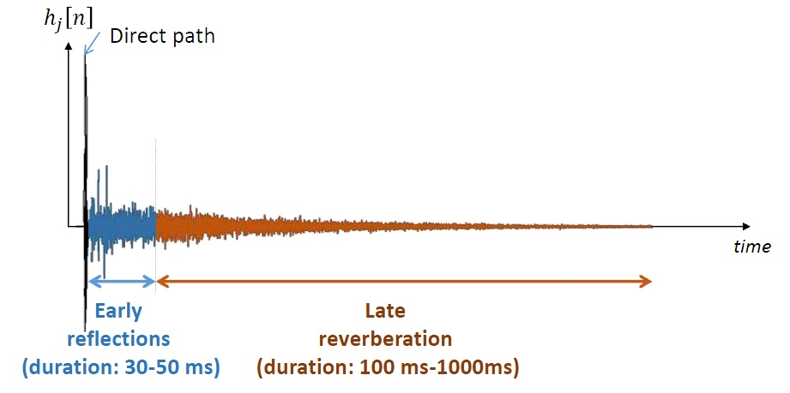
Advances in AVS Based DOA Estimation
Free space model
Covariance-based estimator, 1994
Intensity-vector based estimator, 1994
Maximum steered response power estimator, 2011
Maximum likelihood estimator, 2012
State-of-the-art techniques
Direct path dominant test, 2014
Estimation consistency, 2017
Low reverberant single source points detection, 2018
Room Impulse Response (RIR)

Slide 15
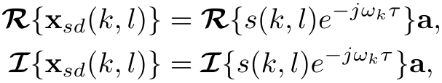
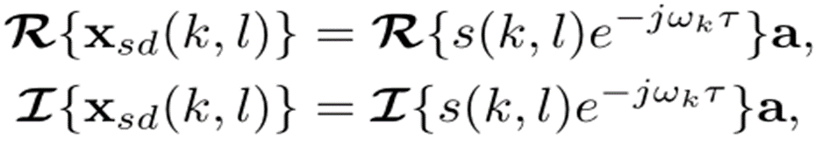
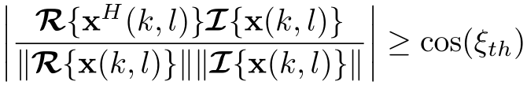
Low Reverberant Single Source Points Detection
The same manifold vector a scaled by different factors makes
and the same direction, i.e., a TF point satisfying
will be detected as an LRSS point.
Wu Kai et al. , 2018.

Slide 16
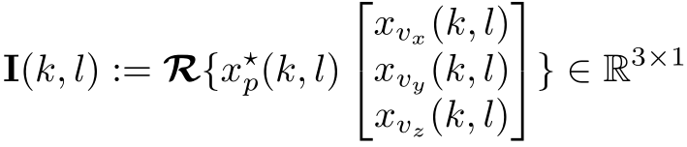
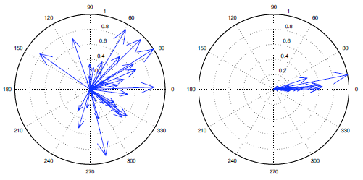
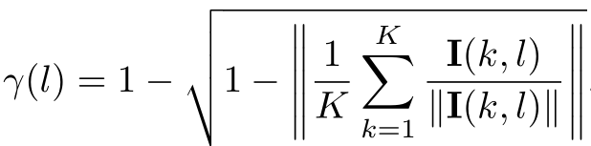
Estimation Consistency
The intensity vector reveals the flux of energy in the sound field.
To evaluate the diffuseness and concentration of intensity vectors.
Hefezi et al. , 2017.

Slide 17
Background
Current Works
Research Plan
References

Slide 18
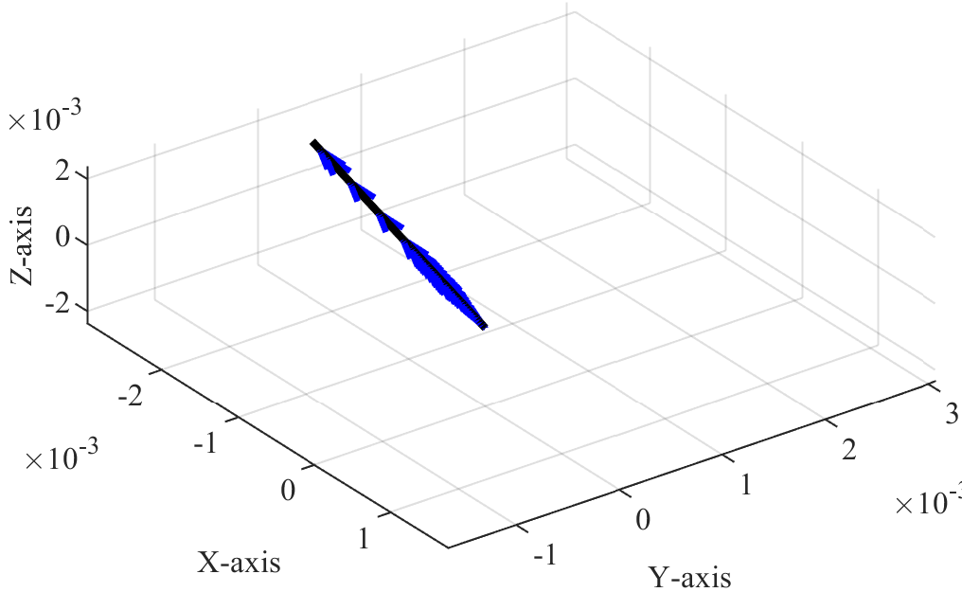
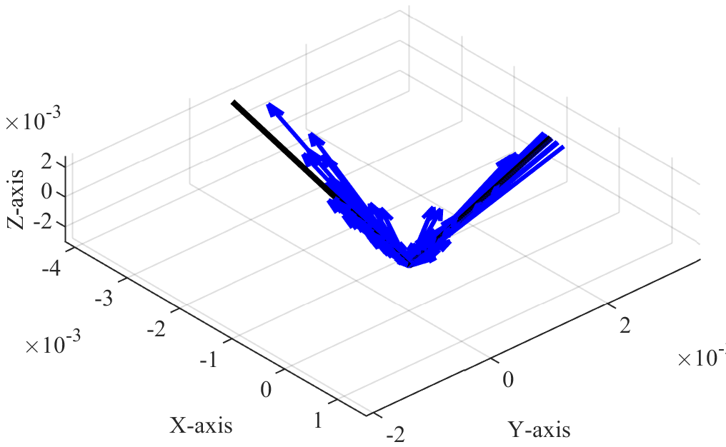
Analysis of EC Technique
With the increasing of simultaneously active sources, the single source dominance assumption within a time frame may be violated.
The normalization of intensity vectors will discard the magnitude information.

Slide 19
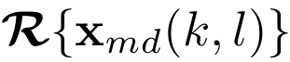

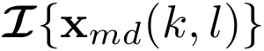


Analysis of LRSS Technique
where
Generally, due to the varying TF characteristic of different incoherent sources.
But considering two closely-separated sources , the similar directions of the real and imaginary part will make these multi-source dominant TF points satisfy LRSS detection rule, i.e., these points will be classified as LRSS points wrongly.

Slide 20
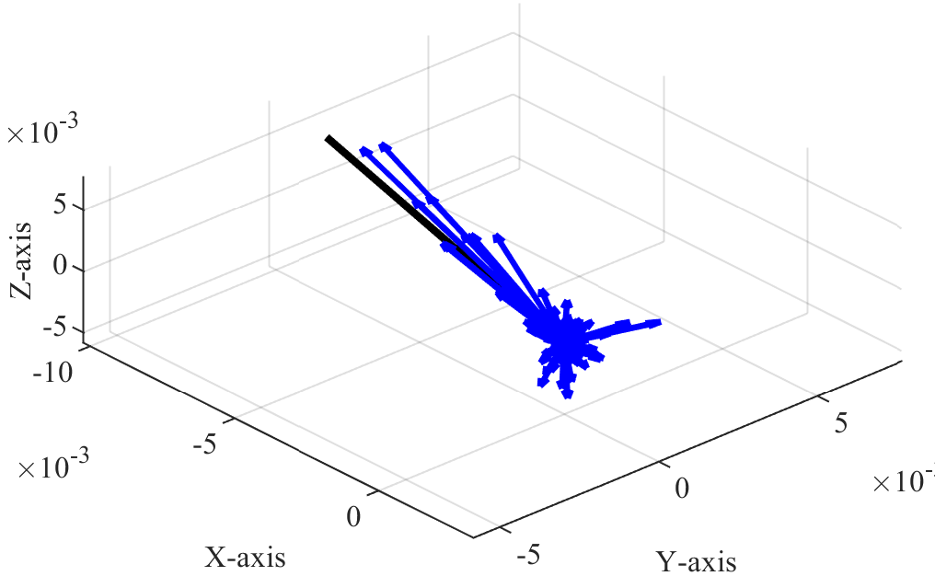

Analysis of Intensity Vector Distribution
$$I_{sd}\left(k,l\right)= x_{p}^{∗}\left(k,l\right)x_{v}\left(k,l\right)= {\left|s (k,l)\right|}^{2}u$$
All estimated IVs are absolutely accurate under this condition.
While in multi-path scenario, although reverberation results in deviating from true DOA, still exist IVs with larger norm point nearby the ground truth.

Slide 21
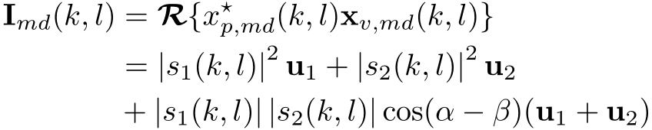
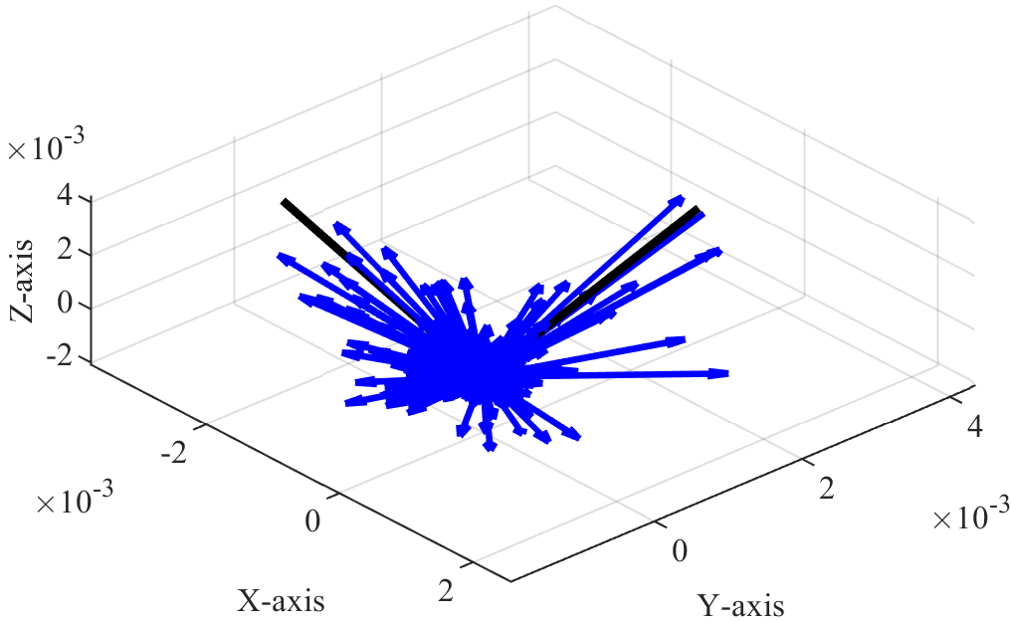
Analysis of Intensity Vector Distribution
where
All IVs lie on the plane formed by and .
The ones with larger norm point toward the similar direction as true DOAs.

Slide 22
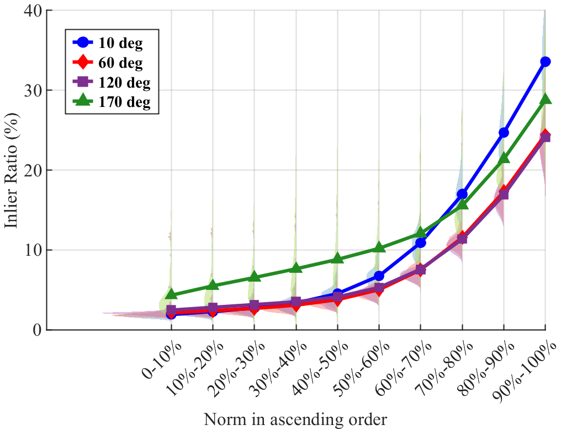


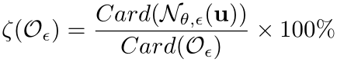
Proposed Method
Step Ⅰ：Outliers Removal Based on Norm Metric
The inlier ratio in different norm set characterizes the density of IVs to the closest true DOA.

Slide 23
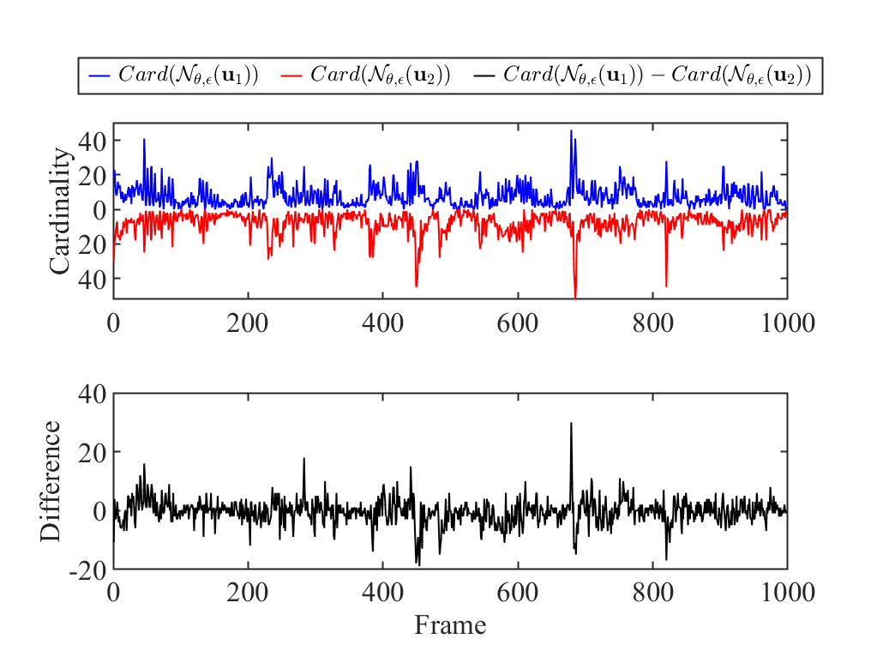


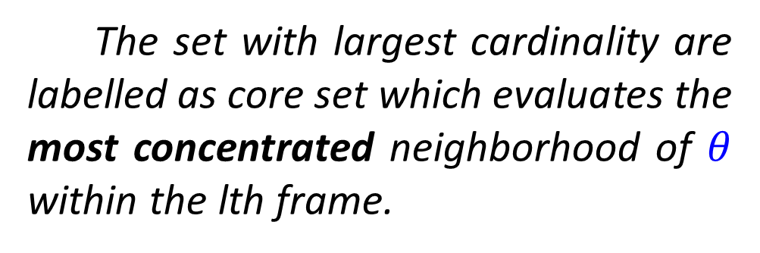
Proposed Method
Step Ⅱ：Inliers Selection in Frame Level
where
The set with largest cardinality are labelled as core set which evaluates the most concentrated neighborhood of $θ$ within the lth frame.

Slide 24
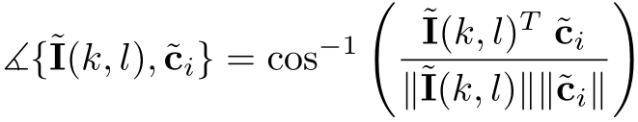
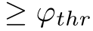
Proposed Method
Step Ⅲ：Inliers Selection in Cluster Level and Outliers Removal Based on Member-to-Centroid Angle Metric
The member-to-centroid angle will be removed as outliers.
Multi-source DOA estimation can be performed to all inlier sets.

Slide 25
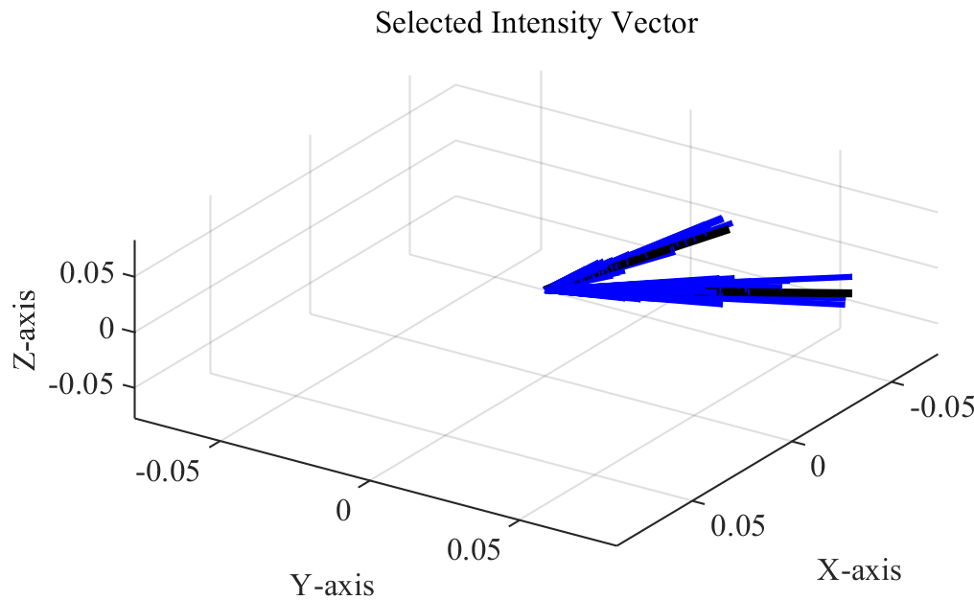


Evaluate Selection Accuracy
Mean Angle versus Angular Separation
Mean Angle | $$5°$$ | $$25°$$ | $$45°$$ | $$60°$$ | $$80°$$ | $$100°$$ | $$140°$$ | $$180°$$
Raw | 36.497 | 34.143 | 33.638 | 33.309 | 33.132 | 32.842 | 32.835 | 32.204
Selected | 5.544 | 5.931 | 5.884 | 5.690 | 5.721 | 5.709 | 5.765 | 5.588

Slide 26


Evaluate DOA Estimation Performance
RMSAE versus Angular Separation

Slide 27


Evaluate Robustness
RMSAE versus T60 and SNR

Slide 28
Conclusion
To address the performance degradation in adjacent sources and simultaneously active sources scenarios, we proposed the multi-level inliers selection and outliers removal (MLISOR) technique which outperforms the SOTA techniques in both accuracy and robustness. The proposed method consists of three steps:
Step Ⅰ：Outliers Removal Based on Norm Metric
Step Ⅱ：Inliers Selection in Frame Level
Step Ⅲ：Inliers Selection in Cluster Level and Outliers Removal Based on
Member-to-Centroid Angle Metric
Based on above-mentioned work, we have submitted a conference paper and the journal one is being written.

Slide 29
Background
Current Works
Research Plan
References

Slide 30









Research Plan Ⅰ
x$[n]$
Fitting model
STFT
x$(k,l)$
Outliers removal based on norm metric
Source number counting
if #1 $source$
if #2 $source$
if #3 $source$
RanSac fitting a line
RanSac fitting a plane
RanSac fitting two planes
I$(k,l)$
I$(k,l)$
I$(k,l)$
DOA estimation
$$u(ψ,φ)$$

Slide 31
Research Plan Ⅱ
Transform the fitting model into an optimization problem.

Slide 32
Background
Current Works
Research Plan
References

Slide 33
References
A. Nehorai and E. Paldi, “Acoustic vector-sensor array processing,” IEEE Transactions on signal processing, vol. 42, no. 9, pp. 2481-2491, 1994.
D. Levin, S. Gannot, and E. A. Habets, “Direction-of-arrival estimation using acoustic vector sensors in the presence of noise,” in 2011 IEEE International Conference on Acoustics, Speech and Signal Processing, 2011, pp. 105-108.
D. Levin, E. A. Habets, and S. Gannot, “Maximum likelihood estimation of direction of arrival using an acoustic vector-sensor,” The Journal of the Acoustical Society of America, vol. 131, no. 2, pp. 1240-1248, 2012.
O. Nadiri and B. Rafaely, “Localization of multiple speakers under high reverberation using a spherical microphone array and the direct-path dominance test,” IEEE/ACM Transactions on Audio, Speech, and Language Processing, vol. 22, no. 10, pp. 1494-1505, 2014.
S. Hafezi, A. H. Moore, and P. A. Naylor, “Multiple source localization using estimation consistency in the time-frequency domain,” in 2017 IEEE International Conference on Acoustics, Speech and Signal Processing, 2017, pp. 516-520.
K, Wu, V. G. Reju, and A. W. Khong, “Multisource doa estimation in a reverberant environment using a single acoustic vector sensor,” IEEE/ACM Transactions on Audio, Speech, and Language Processing, vol. 26, no. 10, pp. 1848-1859, 2018.

Slide 34
Thanks！

